Slide 1


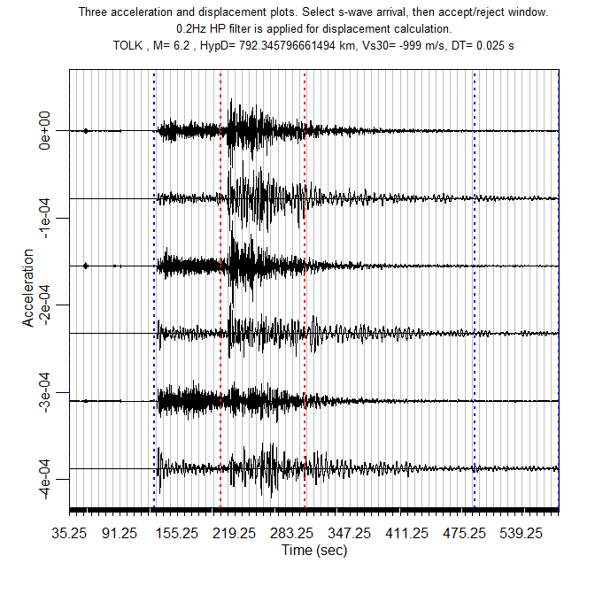
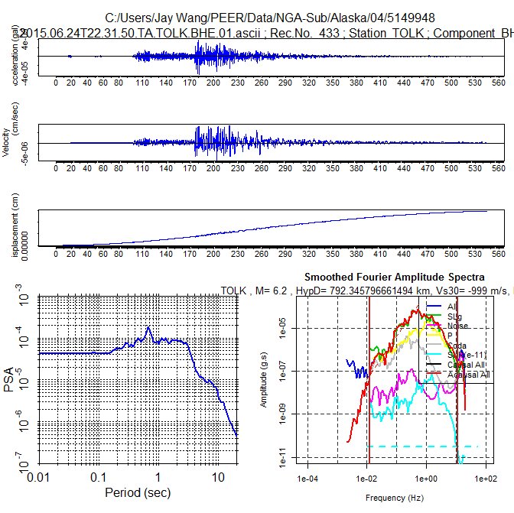
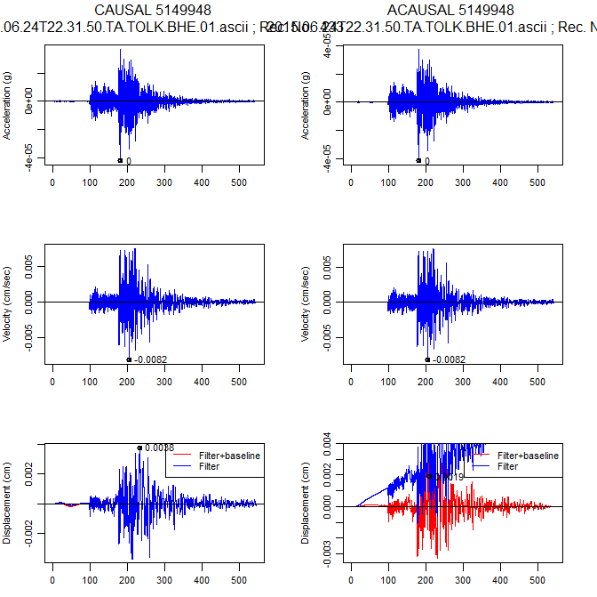
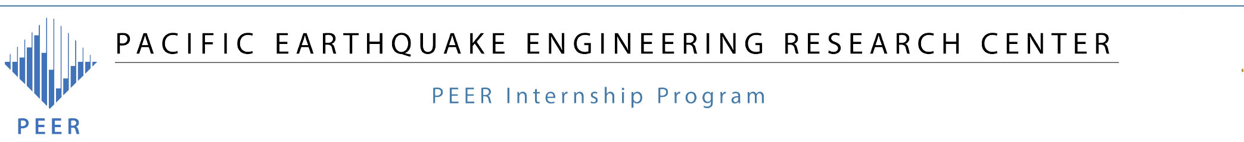
Data Analysis for NGA-Subduction Zone
PEER Internship Program – Summer 2015
Undergraduate Intern: Jianqin Wang, The Cooper Union for the Advancement of Science and Art Intern Mentors: Dr. Tadahiro Kishida, University of California Berkeley
Introduction
One of the world’s largest subduction zones is located at the Aleutian trench near Alaska, where the Pacific plate is being subducted beneath the North American plate. Researchers monitor the activity of the subduction zone through various recording stations. The recordings of the earthquakes are then used to calculate information such as hypocenter locations, hypocenter depths, and magnitudes. In the NGA-Subduction project, the recordings are further processed for filtering and baseline corrections, RotD calculations, and type classifications.
Process
The earthquake recordings are processed using a R program. For each specific event being processed, the program takes the earthquake recording, station info (including station location and distance from hypocenter), and instrument response of the recording equipment and produces three recordings for each station location. The three recordings correspond to North-South, East-West, Up-Down directions. To apply filtering and baseline corrections to recordings, the user must then select two starting times: firstly for the p-wave (also known as primary or compressional wave) start time, secondly for the s-wave (also known as shear wave) start time. This interface is shown in Figure 1. Upon selecting these two start times, the program will then calculate the acceleration, velocity, and displacement of the wave recordings (see Figure 1). Using the calculated smooth Fourier Amplitude Spectra (FAS), the user then removes noise based on the signal vs. response curve (where the signal is preferably three times stronger than the instrument response). The program uses this information and processes the recording using two different filters, causal and acausal butterworth filters.
Once the data is processed, the earthquake events are categorized into subduction interface, subduction intraslab, subduction outer rise, and shallow crustal events. Such classifications are determined based on hypocenter location, depth, and existing reports written about the events.
R code is used extensively throughout the project.
Results
The NGA-Subduction project is still ongoing, and includes many other subduction zones, such as the Cascadia fault line and the Japan trench. For the Alaska subduction zone, 141 events were processed of magnitude 5 or greater, with data from 7 networks and 176 stations. The number of records processed for the Aleutian trench totals to more than 7,500.
The data is currently being processed so that for each individual event, the hypercenter is marked on the map, while the stations with recordings that were processed will also be located. A scatterplot will also be created to mark the distance of each station from the hypocenter, relative to the as-recorded PGA from each station.
Figure. 1 Start Time Selection
Conclusions
The process of analyzing earthquakes events is ongoing, as tectonic plates are in constant motion and new events are produced daily. Thus, the project needs to be constantly updated to account for the newer events. The processed data is important for future studies researchers wish to conduct, as it includes years worth of data from earthquake subduction zones across the world.
Figure 2. FAS Selection
Acknowledgements
I would like to thank PEER for giving me this opportunity to participate in this project. I would also like to thank Dr. Tadahiro Kishida for his daily support and guidance, and Sahar Derakhshan who has never hesitated to help me when I had questions.
Figure 3. Causal/Acausal Filter
References
Ghofrani, H. and Atkinson, G. M. (2011), “Forearc versus Backarc Attenuation of Earthquake Ground Motion”, <http://www.researchgate.net/publication/257920749>, (July 10, 2015).

